Slide 1
Chapter 7
Basic Types

Slide 2
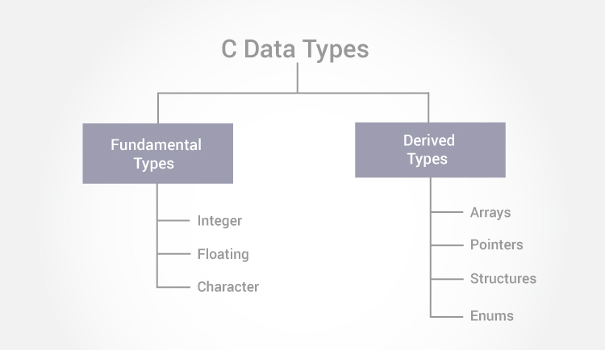
Basic Types
C’s basic (built-in) types:
Integer types
long integers, short integers, and unsigned integers
Floating types
float, double, and long double
char
_Bool (C99)
 | Types & Description
1 | Basic Types They are arithmetic types and are further classified into: (a) integer types and (b) floating-point types.
2 | Enumerated types They are again arithmetic types and they are used to define variables that can only assign certain discrete integer values throughout the program.
3 | The type void The type specifier void indicates that no value is available.
4 | Derived types They include (a) Pointer types, (b) Array types, (c) Structure types, (d) Union types and (e) Function types.

Slide 3
Integer Types
C supports two fundamentally different kinds of numeric types: integer types and floating types.
Values of an integer type are whole numbers.
Values of a floating type can have a fractional part as well.
The integer types, in turn, are divided into two categories: signed and unsigned.

Slide 4
Signed and Unsigned Integers
The leftmost bit of a signed integer (known as the sign bit) is 0 if the number is positive or zero, 1 if it’s negative.
The largest 16-bit integer has the binary representation 0111111111111111, = 32,767 (2¹⁵ – 1).
The largest 32-bit integer is 01111111111111111111111111111111, = 2,147,483,647 (2³¹ – 1).
An integer with no sign bit (the leftmost bit is considered part of the number’s magnitude) is said to be unsigned.
The largest 16-bit unsigned integer is 65,535 (2¹⁶ – 1).
The largest 32-bit unsigned integer is 4,294,967,295 (2³² – 1).

Slide 5
Signed and Unsigned Integers
By default, integer variables are signed in C—the leftmost bit is reserved for the sign.
To tell the compiler that a variable has no sign bit, declare it to be unsigned.
Unsigned numbers are primarily useful for systems programming and low-level, machine-dependent applications.

Slide 6
Integer Types
The int type is usually 32 bits, but may be 16 bits on older CPUs.
Long integers may have more bits than ordinary integers; short integers may have fewer bits.
The specifiers long and short, as well as signed and unsigned, can be combined with int to form integer types.
Only six combinations produce different types:
short int unsigned short int
int unsigned int
long int unsigned long int
The order of the specifiers doesn’t matter. Also, the word int can be dropped
long int can be abbreviated to just long).

Slide 7
Integer Types
The range of values represented by each of the six integer types varies from one machine to another.
However, the C standard requires that short int, int, and long int must each cover a certain minimum range of values.
Also, int must not be shorter than short int, and long int must not be shorter than int.

Slide 8
Integer Types
Typical ranges of values for the integer types on a 16-bit machine:
Type Smallest Value Largest Value
short int –32,768 32,767
unsigned short int 0 65,535
int –32,768 32,767
unsigned int 0 65,535
long int –2,147,483,648 2,147,483,647
unsigned long int 0 4,294,967,295

Slide 9
Integer Types
Typical ranges on a 32-bit machine:
Type Smallest Value Largest Value
short int –32,768 32,767
unsigned short int 0 65,535
int –2,147,483,648 2,147,483,647
unsigned int 0 4,294,967,295
long int –2,147,483,648 2,147,483,647
unsigned long int 0 4,294,967,295

Slide 10
Integer Types
Typical ranges on a 64-bit machine:
Type Smallest Value Largest Value
short int –32,768 32,767
unsigned short int 0 65,535
int –2,147,483,648 2,147,483,647
unsigned int 0 4,294,967,295
long int –2⁶³ 2⁶³–1
unsigned long int 0 2⁶⁴–1
The <limits.h> header defines macros that represent the smallest and largest values of each integer type.

Slide 11
Integer Types in C99
C99 provides two additional standard integer types, long long int and unsigned long long int.
Both long long types are required to be at least 64 bits wide.
The range of long long int values is typically –2⁶³ (–9,223,372,036,854,775,808) to 2⁶³ – 1 (9,223,372,036,854,775,807).
The range of unsigned long long int values is usually 0 to 2⁶⁴ – 1 (18,446,744,073,709,551,615).

Slide 12
Integer Types in C99
The short int, int, long int, and long long int types (along with the signed char type) are called standard signed integer types in C99.
The unsigned short int, unsigned int, unsigned long int, and unsigned long long int types (along with the unsigned char type and the _Bool type) are called standard unsigned integer types.
In addition to the standard integer types, the C99 standard allows implementation-defined extended integer types, both signed and unsigned.

Slide 13
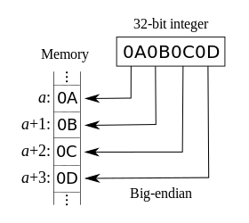
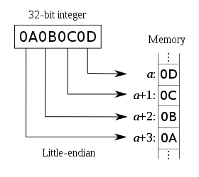
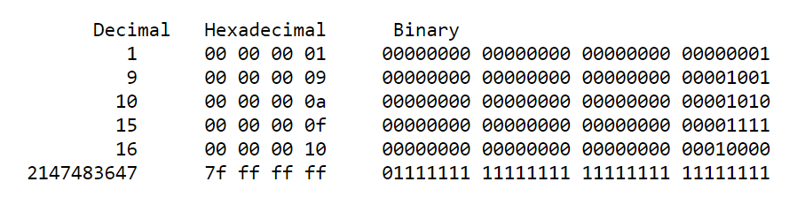
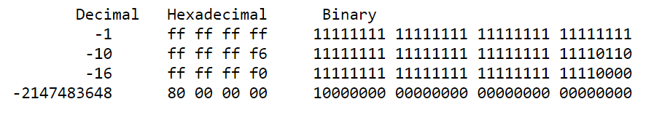
x86-64 series of processors use the little-endian format

Slide 14
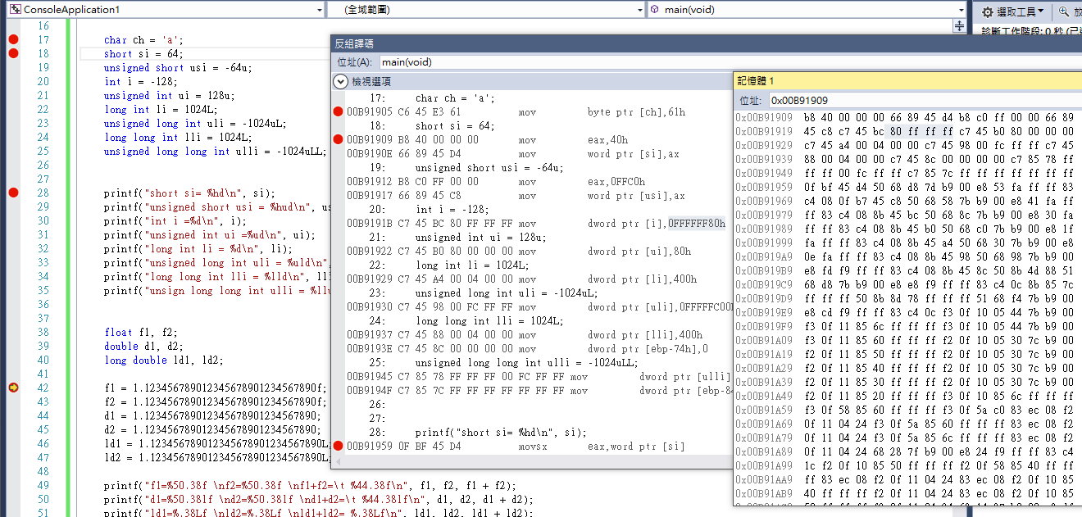

Slide 15
Integer Constants
Constants are numbers that appear in the text of a program.
C allows integer constants to be written in
decimal (base 10),
octal (base 8), or
hexadecimal (base 16).

Slide 16
Octal and Hexadecimal Numbers
Octal numbers use only the digits 0 through 7.
Each position in an octal number represents a power of 8.
The octal number 237 represents the decimal number 2 × 8² + 3 × 8¹ + 7 × 8⁰ = 128 + 24 + 7 = 159.
A hexadecimal (or hex) number is written using the digits 0 through 9 plus the letters A through F, which stand for 10 through 15, respectively.
The hex number 1AF has the decimal value 1 × 16² + 10 × 16¹ + 15 × 16⁰ = 256 + 160 + 15 = 431.

Slide 17
Integer Constants
Decimal constants contain digits between 0 and 9, but must not begin with a zero:
15 255 32767
Octal constants contain only digits between 0 and 7, and must begin with a zero:
017 0377 077777
Hexadecimal constants contain digits between 0 and 9 and letters between a and f, and always begin with 0x:
0xf 0xff 0x7fff
The letters in a hexadecimal constant may be either upper or lower case:
0xff 0xfF 0xFf 0xFF 0Xff 0XfF 0XFf 0XFF

Slide 18
Integer Constants
The type of a decimal integer constant is normally int.
If the value of the constant is too large to store as an int, the constant has type long int instead.
If the constant is too large to store as a long int, the compiler will try unsigned long int as a last resort.
For an octal or hexadecimal constant, the rules are slightly different: the compiler will go through the types int, unsigned int, long int, and unsigned long int until it finds one capable of representing the constant.

Slide 19
Integer Constants
To force the compiler to treat a constant as a long integer, just follow it with the letter L (or l):
15L 0377L 0x7fffL
To indicate that a constant is unsigned, put the letter U (or u) after it:
15U 0377U 0x7fffU
L and U may be used in combination:
0xffffffffUL
The order of the L and U doesn’t matter, nor does their case.

Slide 20
Integer Constants in C99
In C99, integer constants that end with either LL or ll (the case of the two letters must match) have type long long int.
Adding the letter U (or u) before or after the LL or ll denotes a constant of type unsigned long long int.
C99’s general rules for determining the type of an integer constant are a bit different from those in C89.
The type of a decimal constant with no suffix (U, u, L, l, LL, or ll) is the “smallest” of the types int, long int, or long long int that can represent the value of that constant.

Slide 21
Integer Constants in C99
For an octal or hexadecimal constant, the list of possible types is int, unsigned int, long int, unsigned long int, long long int, and unsigned long long int, in that order.
Any suffix at the end of a constant changes the list of possible types.
A constant that ends with U (or u) must have one of the types unsigned int, unsigned long int, or unsigned long long int.
A decimal constant that ends with L (or l) must have one of the types long int or long long int.

Slide 22
Integer Overflow
When arithmetic operations are performed on integers, it’s possible that the result will be too large to represent.
For example, when an arithmetic operation is performed on two int values, the result must be able to be represented as an int.
If the result can’t be represented as an int (because it requires too many bits), we say that overflow has occurred.

Slide 23
Integer Overflow
The behavior when integer overflow occurs depends on whether the operands were signed or unsigned.
When overflow occurs during an operation on signed integers, the program’s behavior is undefined.
When overflow occurs during an operation on unsigned integers, the result is defined: we get the correct answer modulo 2^{n}, where n is the number of bits used to store the result.

Slide 24
Reading and Writing Integers
Reading and writing unsigned, short, and long integers requires new conversion specifiers.
When reading or writing an unsigned integer, use the letter u, o, or x instead of d in the conversion specification.
unsigned int u;
scanf("%u", &us); /* reads u in base 10 */
printf("%u", us); /* writes u in base 10 */
scanf("%o", &uo); /* reads u in base 8 */
printf("%o", uo); /* writes u in base 8 */
scanf("%x", &ux); /* reads u in base 16 */
printf("%x", ux); /* writes u in base 16 */

Slide 25
Reading and Writing Integers
When reading or writing a short integer, put the letter h in front of d, o, u, or x:
short s;
scanf("%hd", &s);
printf("%hd", s);
When reading or writing a long integer, put the letter l (“ell,” not “one”) in front of d, o, u, or x.
When reading or writing a long long integer (C99 only), put the letters ll in front of d, o, u, or x.

Slide 26
Program: Summing a Series of Numbers (Revisited)
The sum.c program (Chapter 6) sums a series of integers.
One problem with this program is that the sum (or one of the input numbers) might exceed the largest value allowed for an int variable.
Here’s what might happen if the program is run on a machine whose integers are 16 bits long:
This program sums a series of integers.
Enter integers (0 to terminate): 10000 20000 30000 0
The sum is: -5536
When overflow occurs with signed numbers, the outcome is undefined.
The program can be improved by using long variables.

Slide 27
/* Sums a series of numbers (using long variables) */
#include <stdio.h>
int main(void)
{
long n, sum = 0;
printf("This program sums a series of integers.\n");
printf("Enter integers (0 to terminate): ");
scanf("%ld", &n);
while (n != 0) {
sum += n;
scanf("%ld", &n);
}
printf("The sum is: %ld\n", sum);
return 0;
}
sum2.c
請用for loop 改寫!

Slide 28
scanf("%ld", &n);
while (n != 0) {
sum += n;
scanf("%ld", &n);
}
for (; scanf("%d", &n), n != 0; sum += n);

Slide 29
Floating Types
C provides three floating types, corresponding to different floating-point formats:
float Single-precision floating-point
double Double-precision floating-point
long double Extended-precision floating-point

Slide 30
Floating Types
float is suitable when the amount of precision isn’t critical.
double provides enough precision for most programs.
long double is rarely used.
The C standard doesn’t state how much precision the float, double, and long double types provide, since that depends on how numbers are stored.
Most modern computers follow the specifications in IEEE Standard 754 (also known as IEC 60559).

Slide 31
The IEEE Floating-Point Standard
IEEE Standard 754 was developed by the Institute of Electrical and Electronics Engineers.
It has two primary formats for floating-point numbers: single precision (32 bits) and double precision (64 bits).
Numbers are stored in a form of scientific notation, with each number having a sign, an exponent, and a fraction.
In single-precision format, the exponent is 8 bits long, while the fraction occupies 23 bits. The maximum value is approximately 3.40 × 10³⁸, with a precision of about 6 decimal digits.

Slide 32
Floating Types
Characteristics of float and double when implemented according to the IEEE standard:
Type Smallest Positive Value Largest Value Precision
float 1.17549 × 10^{–38} 3.40282 × 10³⁸ 6 digits
double 2.22507 × 10^{–308} 1.79769 × 10³⁰⁸ 15 digits
On computers that don’t follow the IEEE standard, this table won’t be valid.
In fact, on some machines, float may have the same set of values as double, or double may have the same values as long double.

Slide 33
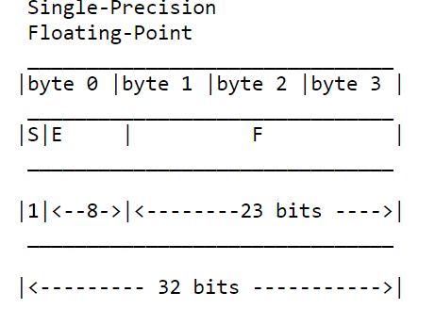
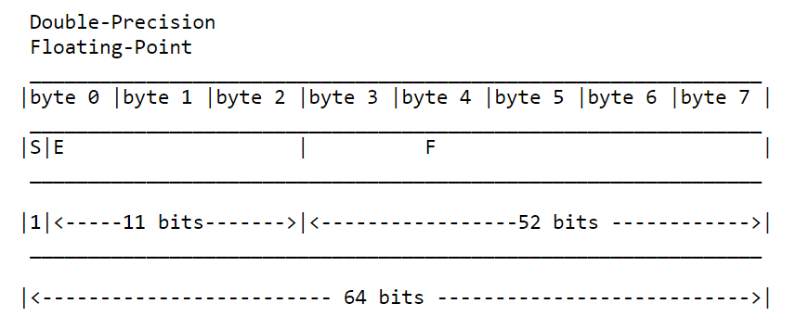

Slide 34
f1= 1.12345683574676513671875000000000000000
f2= 1.12345683574676513671875000000000000000
f1+f2= 2.24691367149353027343750000000000000000
d1= 1.12345678901234569124767403991427272558
d2= 1.12345678901234569124767403991427272558
d1+d2= 2.24691357802469138249534807982854545116
ld1= 1.12345678901234569124767403991427272558
ld2= 1.12345678901234569124767403991427272558
ld1+ld2= 2.24691357802469138249534807982854545116
float f1, f2;
double d1, d2;
long double ld1, ld2;
f1 = 1.123456789012345678901234567890f;
f2 = 1.123456789012345678901234567890f;
d1 = 1.123456789012345678901234567890;
d2 = 1.123456789012345678901234567890;
ld1 = 1.123456789012345678901234567890L;
ld2 = 1.123456789012345678901234567890L;
printf("f1=%50.38f \nf2=%50.38f \nf1+f2=\t %44.38f\n", f1, f2, f1 + f2);
printf("d1=%50.38lf \nd2=%50.38lf \nd1+d2=\t %44.38lf\n", d1, d2, d1 + d2);
printf("ld1=%50.38Lf \nld2=%50.38Lf \nld1+ld2= %45.38Lf\n", ld1, ld2, ld1 + ld2);

Slide 35
Floating Types
Macros that define the characteristics of the floating types can be found in the <float.h> header.
In C99, the floating types are divided into two categories.
Real floating types (float, double, long double)
Complex types (float _Complex, double _Complex, long double _Complex)

Slide 36
Floating Constants
Floating constants can be written in a variety of ways.
Valid ways of writing the number 57.0:
57.0 57. 57.0e0 57E0 5.7e1 5.7e+1
.57e2 570.e-1
A floating constant must contain a decimal point and/or an exponent; the exponent indicates the power of 10 by which the number is to be scaled.
If an exponent is present, it must be preceded by the letter E (or e). An optional + or - sign may appear after the E (or e).

Slide 37
Floating Constants
By default, floating constants are stored as double-precision numbers.
To indicate that only single precision is desired, put the letter F (or f) at the end of the constant (for example, 57.0F).
To indicate that a constant should be stored in long double format, put the letter L (or l) at the end (57.0L).

Slide 38
Reading and Writing Floating-Point Numbers
The conversion specifications %e, %f, and %g are used for reading and writing single-precision floating-point numbers.
When reading a value of type double, put the letter l in front of e, f, or g:
double d;
scanf("%lf", &d);
Note: Use l only in a scanf format string, not a printf string.
In a printf format string, the e, f, and g conversions can be used to write either float or double values.
When reading or writing a value of type long double, put the letter L in front of e, f, or g.

Slide 39
Character Types
The only remaining basic type is char, the character type.
The values of type char can vary from one computer to another, because different machines may have different underlying character sets.

Slide 40
Character Sets
Today’s most popular character set is ASCII (American Standard Code for Information Interchange), a 7-bit code capable of representing 128 characters.
ASCII is often extended to a 256-character code known as Latin-1 that provides the characters necessary for Western European and many African languages.

Slide 41
Character Sets
A variable of type char can be assigned any single character:
char ch;
ch = 'a'; /* lower-case a */
ch = 'A'; /* upper-case A */
ch = '0'; /* zero */
ch = ' '; /* space */
Notice that character constants are enclosed in single quotes, not double quotes.

Slide 42
Operations on Characters
Working with characters in C is simple, because of one fact: C treats characters as small integers.
In ASCII, character codes range from 0000000 to 1111111, which we can think of as the integers from 0 to 127.
The character 'a' has the value 97, 'A' has the value 65, '0' has the value 48, and ' ' has the value 32.
Character constants actually have int type rather than char type.

Slide 43
Operations on Characters
When a character appears in a computation, C uses its integer value.
Consider the following examples, which assume the ASCII character set:
char ch;
int i;
i = 'a'; /* i is now 97 */
ch = 65; /* ch is now 'A' */
ch = ch + 1; /* ch is now 'B' */
ch++; /* ch is now 'C' */

Slide 44
Operations on Characters
Characters can be compared, just as numbers can.
An if statement that converts a lower-case letter to upper case:
if ('a' <= ch && ch <= 'z')
ch = ch - 'a' + 'A';
Comparisons such as 'a' <= ch are done using the integer values of the characters involved.
These values depend on the character set in use, so programs that use <, <=, >, and >= to compare characters may not be portable.

Slide 45
Operations on Characters
The fact that characters have the same properties as numbers has advantages.
For example, it is easy to write a for statement whose control variable steps through all the upper-case letters:
for (ch = 'A'; ch <= 'Z'; ch++) …
Disadvantages of treating characters as numbers:
Can lead to errors that won’t be caught by the compiler.
Allows meaningless expressions such as'a' * 'b' / 'c'.
Can hamper portability, since programs may rely on assumptions about the underlying character set.

Slide 46
Signed and Unsigned Characters
The char type—like the integer types—exists in both signed and unsigned versions.
Signed characters normally have values between –128 and 127. Unsigned characters have values between 0 and 255.
C allows the use of the words signed and unsigned to modify char:
signed char sch;
unsigned char uch;

Slide 47
Signed and Unsigned Characters
C89 uses the term integral types to refer to both the integer types and the character types.
Enumerated types are also integral types.
C99 doesn’t use the term “integral types.”
Instead, it expands the meaning of “integer types” to include the character types and the enumerated types.
C99’s _Bool type is considered to be an unsigned integer type.

Slide 48
Arithmetic Types
The integer types and floating types are collectively known as arithmetic types.
A summary of the arithmetic types in C89, divided into categories and subcategories:
Integral types
char
Signed integer types (signed char, short int, int, long int)
Unsigned integer types (unsigned char, unsigned short int, unsigned int, unsigned long int)
Enumerated types
Floating types (float, double, long double)

Slide 49
Arithmetic Types
C99 has a more complicated hierarchy:
Integer types
char
Signed integer types, both standard (signed char, short int, int, long int, long long int) and extended
Unsigned integer types, both standard (unsigned char, unsigned short int, unsigned int, unsigned long int, unsigned long long int, _Bool) and extended
Enumerated types
Floating types
Real floating types (float, double, long double)
Complex types (float _Complex, double _Complex, long double _Complex)

Slide 50
Escape Sequences
A character constant is usually one character enclosed in single quotes.
However, certain special characters—including the new-line character—can’t be written in this way, because they’re invisible (nonprinting) or because they can’t be entered from the keyboard.
Escape sequences provide a way to represent these characters.
There are two kinds of escape sequences: character escapes and numeric escapes.

Slide 51
Escape Sequences
A complete list of character escapes:
Name Escape Sequence
Alert (bell) \a
Backspace \b
Form feed \f
New line \n
Carriage return \r
Horizontal tab \t
Vertical tab \v
Backslash \\
Question mark \?
Single quote \'
Double quote \"

Slide 52
Escape Sequences
Character escapes are handy, but they don’t exist for all nonprinting ASCII characters.
Character escapes are also useless for representing characters beyond the basic 128 ASCII characters.
Numeric escapes, which can represent any character, are the solution to this problem.
A numeric escape for a particular character uses the character’s octal or hexadecimal value.
For example, the ASCII escape character (decimal value: 27) has the value 33 in octal and 1B in hex.

Slide 53
Escape Sequences
An octal escape sequence consists of the \ character followed by an octal number with at most three digits, such as \33 or \033.
A hexadecimal escape sequence consists of \x followed by a hexadecimal number, such as \x1b or \x1B.
The x must be in lower case, but the hex digits can be upper or lower case.

Slide 54
Escape Sequences
When used as a character constant, an escape sequence must be enclosed in single quotes.
For example, a constant representing the escape character would be written '\33' (or '\x1b').
Escape sequences tend to get a bit cryptic, so it’s often a good idea to use #define to give them names:
#define ESC '\33'
Escape sequences can be embedded in strings as well.

Slide 55
printf("This sentence is here %c", '\r');
printf("xxxx");
printf("\n");
printf("This sentence is here %c", 13);
printf("xxxx");
printf("\n");
printf("This sentence is here %c", '\015');
printf("xxxx");
printf("\n");
printf("This sentence is here %c", '\xd');
printf("xxxx");
This sentence is here
xxxx sentence is here

Slide 56
Character-Handling Functions
Calling C’s toupper library function is a fast and portable way to convert case:
ch = toupper(ch);
toupper returns the upper-case version of its argument.
Programs that call toupper need to have the following #include directive at the top:
#include <ctype.h>
The C library provides many other useful character-handling functions.

Slide 57
Toupper() example
ch = toupper(ch); =
lower-case letter to upper case:
if ('a' <= ch && ch <= 'z')
ch = ch - 'a' + 'A';
#include <stdio.h>
#include <ctype.h>
#include <limits.h>
…
for (unsigned char i=0, u; i<UCHAR_MAX; i++)
{
u = toupper(i);
if (i !=u) printf("%c%c ", i,u);
}
…
Output= ?
aA bB cC dD eE fF gG hH iI jJ kK lL mM nN oO pP qQ rR sS tT uU vV wW xX yY zZ

Slide 58
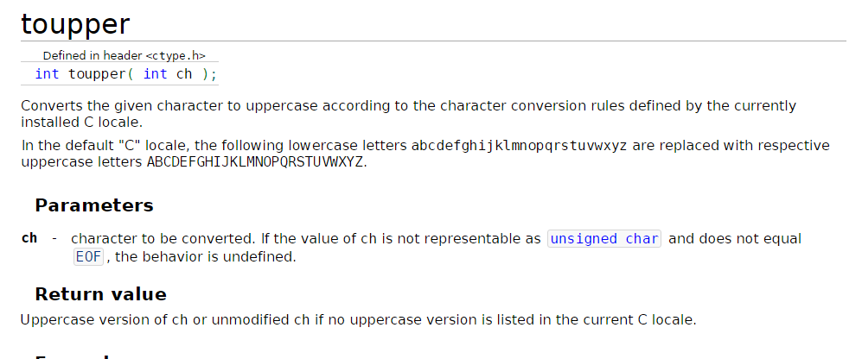

Slide 59
Reading and Writing Characters Using scanf and printf
The %c conversion specification allows scanf and printf to read and write single characters:
char ch;
scanf("%c", &ch); /* reads one character */
printf("%c", ch); /* writes one character */
scanf doesn’t skip white-space characters.
To force scanf to skip white space before reading a character, put a space in its format string just before %c:
scanf(" %c", &ch);

Slide 60
Reading and Writing Characters Using scanf and printf
Since scanf doesn’t normally skip white space, it’s easy to detect the end of an input line: check to see if the character just read is the new-line character.
A loop that reads and ignores all remaining characters in the current input line:
do {
scanf("%c", &ch);
} while (ch != '\n');
When scanf is called the next time, it will read the first character on the next input line.

Slide 61
Reading and Writing Characters Using getchar and putchar
For single-character input and output, getchar and putchar are an alternative to scanf and printf.
putchar writes a character:
putchar(ch);
Each time getchar is called, it reads one character, which it returns:
ch = getchar();
getchar returns an int value rather than a char value, so ch will often have type int.
Like scanf, getchar doesn’t skip white-space characters as it reads.

Slide 62
Reading and Writing Characters Using getchar and putchar
Using getchar and putchar (rather than scanf and printf) saves execution time.
getchar and putchar are much simpler than scanf and printf, which are designed to read and write many kinds of data in a variety of formats.
They are usually implemented as macros for additional speed.
getchar has another advantage. Because it returns the character that it reads, getchar lends itself to various C idioms.

Slide 63
Reading and Writing Characters Using getchar and putchar
Consider the scanf loop that we used to skip the rest of an input line:
do {
scanf("%c", &ch);
} while (ch != '\n');
Rewriting this loop using getchar gives us the following:
do {
ch = getchar();
} while (ch != '\n');

Slide 64
Reading and Writing Characters Using getchar and putchar
Moving the call of getchar into the controlling expression to condense the loop:
while ((ch = getchar()) != '\n')
;
The ch variable isn’t even needed;
while (getchar() != '\n');
do {
ch = getchar();
} while (ch != '\n');

Slide 65
Reading and Writing Characters Using getchar and putchar
getchar is useful in loops that skip characters as well as loops that search for characters.
A statement that uses getchar to skip an indefinite number of blank characters:
while ((ch = getchar()) == ' ')
;
When the loop terminates, ch will contain the first nonblank character that getchar encountered.

Slide 66
Reading and Writing Characters Using getchar and putchar
Be careful when mixing getchar and scanf.
scanf has a tendency to leave behind characters that it has “peeked” at but not read, including the new-line character:
printf("Enter an integer: ");
scanf("%d", &i);
printf("Enter a command: ");
command = getchar();
scanf will leave behind any characters that weren’t consumed during the reading of i, including (but not limited to) the new-line character.
getchar will fetch the first leftover character.

Slide 67
Program: Determining the Length of a Message
The length.c program displays the length of a message entered by the user:
Enter a message: Brevity is the soul of wit.
Your message was 27 character(s) long.
The length includes spaces and punctuation, but not the new-line character at the end of the message.
We could use either scanf or getchar to read characters; most C programmers would choose getchar.
length2.c is a shorter program that eliminates the variable used to store the character read by getchar.

Slide 68
// Determines the length of a message
#include <stdio.h>
int main(void)
{
char ch;
int len = 0;
printf("Enter a message: ");
ch = getchar();
while (ch != '\n')
{
len++;
ch = getchar();
}
printf("Your message was %d character(s) long.\n", len);
return 0;
}

Slide 69
// Determines the length of a message
#include <stdio.h>
int main(void)
{
int len = 0;
printf("Enter a message: ");
while (getchar() != '\n')
len++;
printf("Your message was %d character(s) long.\n", len);
return 0;
}

Slide 70
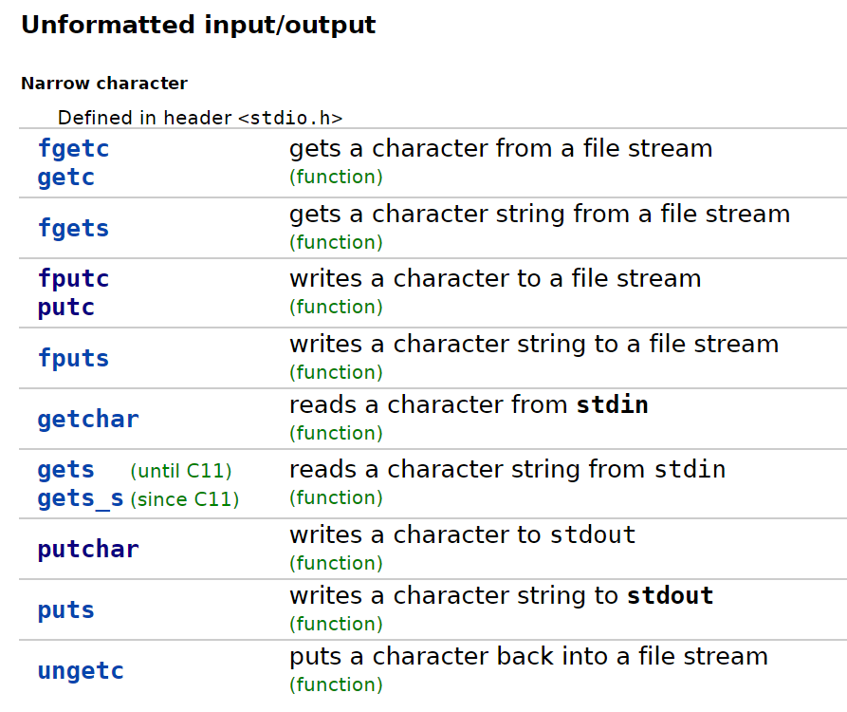

Slide 71
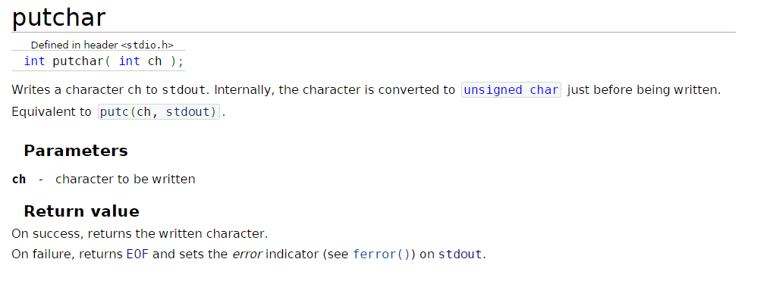

Slide 72
Type Conversion
For a computer to perform an arithmetic operation, the operands must usually be of the same size (the same number of bits) and be stored in the same way.
When operands of different types are mixed in expressions, the C compiler may have to generate instructions that change the types of some operands so that hardware will be able to evaluate the expression.
If we add a 16-bit short and a 32-bit int, the compiler will arrange for the short value to be converted to 32 bits.
If we add an int and a float, the compiler will arrange for the int to be converted to float format.

Slide 73
Type Conversion
Because the compiler handles these conversions automatically, without the programmer’s involvement, they’re known as implicit conversions.
C also allows the programmer to perform explicit conversions, using the cast operator.
The rules for performing implicit conversions are somewhat complex, primarily because C has so many different arithmetic types.

Slide 74
Type Conversion
Implicit conversions are performed:
When the operands in an arithmetic or logical expression don’t have the same type. (C performs what are known as the usual arithmetic conversions.)
When the type of the expression on the right side of an assignment doesn’t match the type of the variable on the left side.
When the type of an argument in a function call doesn’t match the type of the corresponding parameter.
When the type of the expression in a return statement doesn’t match the function’s return type.
Chapter 9 discusses the last two cases.

Slide 75
The Usual Arithmetic Conversions
The usual arithmetic conversions are applied to the operands of most binary operators.
If f has type float and i has type int, the usual arithmetic conversions will be applied to the operands in the expression f + i.
Clearly it’s safer to convert i to type float (matching f’s type) rather than convert f to type int (matching i’s type).
When an integer is converted to float, the worst that can happen is a minor loss of precision.
Converting a floating-point number to int, on the other hand, causes the fractional part of the number to be lost. Worse still, the result will be meaningless if the original number is larger than the largest possible integer or smaller than the smallest integer.

Slide 76
The Usual Arithmetic Conversions
Strategy behind the usual arithmetic conversions: convert operands to the “narrowest” type that will safely accommodate both values.
Operand types can often be made to match by converting the operand of the narrower type to the type of the other operand (this act is known as promotion).
Common promotions include the integral promotions, which convert a character or short integer to type int (or to unsigned int in some cases).
The rules for performing the usual arithmetic conversions can be divided into two cases:
The type of either operand is a floating type.
Neither operand type is a floating type.

Slide 77
The Usual Arithmetic Conversions
The type of either operand is a floating type.
If one operand has type long double, then convert the other operand to type long double.
Otherwise, if one operand has type double, convert the other operand to type double.
Otherwise, if one operand has type float, convert the other operand to type float.
Example: If one operand has type long int and the other has type double, the long int operand is converted to double.

Slide 78
The Usual Arithmetic Conversions
Neither operand type is a floating type. First perform integral promotion on both operands.
Then use the following diagram to promote the operand whose type is narrower:
unsigned long int
long int
unsigned int
int

Slide 79
The Usual Arithmetic Conversions
When a signed operand is combined with an unsigned operand, the signed operand is converted to an unsigned value.
This rule can cause obscure programming errors.
It’s best to use unsigned integers as little as possible and, especially, never mix them with signed integers.

Slide 80
The Usual Arithmetic Conversions
Example of the usual arithmetic conversions:
char c;
short int s;
int i;
unsigned int u;
long int l;
unsigned long int ul;
float f;
double d;
long double ld;
i = i + c; /* c is converted to int */
i = i + s; /* s is converted to int */
u = u + i; /* i is converted to unsigned int */
l = l + u; /* u is converted to long int */
ul = ul + l;/* l is converted to unsigned long int */
f = f + ul; /* ul is converted to float */
d = d + f; /* f is converted to double */
ld = ld + d;/* d is converted to long double */

Slide 81
Conversion During Assignment
The usual arithmetic conversions don’t apply to assignment.
Instead, the expression on the right side of the assignment is converted to the type of the variable on the left side:
char c;
int i;
float f;
double d;
i = c; /* c is converted to int */
f = i; /* i is converted to float */
d = f; /* f is converted to double */

Slide 82
Conversion During Assignment
Assigning a floating-point number to an integer variable drops the fractional part of the number:
int i;
i = 842.97; /* i is now 842 */
i = -842.97; /* i is now -842 */
Assigning a value to a variable of a narrower type will give a meaningless result (or worse) if the value is outside the range of the variable’s type:
c = 10000; /*** WRONG ***/
i = 1.0e20; /*** WRONG ***/
f = 1.0e100; /*** WRONG ***/

Slide 83
Conversion During Assignment
It’s a good idea to append the f suffix to a floating-point constant if it will be assigned to a float variable:
f = 3.14159f;
Without the suffix, the constant 3.14159 would have type double, possibly causing a warning message.

Slide 84
Implicit Conversions in C99
C99’s rules for implicit conversions are somewhat different.
Each integer type has an “integer conversion rank.”
Ranks from highest to lowest:
1. long long int, unsigned long long int
2. long int, unsigned long int
3. int, unsigned int
4. short int, unsigned short int
5. char, signed char, unsigned char
6. _Bool
C99’s “integer promotions” involve converting any type whose rank is less than int and unsigned int to int (provided that all values of the type can be represented using int) or else to unsigned int.

Slide 85
Implicit Conversions in C99
C99’s rules for performing the usual arithmetic conversions can be divided into two cases:
The type of either operand is a floating type.
Neither operand type is a floating type.
The type of either operand is a floating type. As long as neither operand has a complex type, the rules are the same as before. (The conversion rules for complex types are discussed in Chapter 27.)

Slide 86
Implicit Conversions in C99
Neither operand type is a floating type. Perform integer promotion on both operands. Stop if the types of the operands are now the same. Otherwise, use the following rules:
If both operands have signed types or both have unsigned types, convert the operand whose type has lesser integer conversion rank to the type of the operand with greater rank.
If the unsigned operand has rank greater or equal to the rank of the type of the signed operand, convert the signed operand to the type of the unsigned operand.
If the type of the signed operand can represent all of the values of the type of the unsigned operand, convert the unsigned operand to the type of the signed operand.
Otherwise, convert both operands to the unsigned type corresponding to the type of the signed operand.

Slide 87
Implicit Conversions in C99
All arithmetic types can be converted to _Bool type.
The result of the conversion is
0 if the original value is 0;
otherwise, the result is 1.

Slide 88
Casting
Although C’s implicit conversions are convenient, we sometimes need a greater degree of control over type conversion.
For this reason, C provides casts.
A cast expression has the form
( type-name ) expression
type-name specifies the type to which the expression should be converted.

Slide 89
Casting
Using a cast expression to compute the fractional part of a float value:
float f, frac_part;
frac_part = f - (int) f;
The difference between f and (int) f is the fractional part of f, which was dropped during the cast.
Cast expressions enable us to document type conversions that would take place anyway:
i = (int) f; /* f is converted to int */

Slide 90
Casting
Cast expressions also let us force the compiler to perform conversions.
Example:
float quotient;
int dividend, divisor;
quotient = dividend / divisor;
To avoid truncation during division, we need to cast one of the operands:
quotient = (float) dividend / divisor;
Casting dividend to float causes the compiler to convert divisor to float also.

Slide 91
Casting
C regards ( type-name ) as a unary operator.
Unary operators have higher precedence than binary operators, so the compiler interprets
(float) dividend / divisor
As ((float) dividend) / divisor
Other ways to accomplish the same effect:
quotient = dividend / (float) divisor;
quotient = (float) dividend / (float) divisor;

Slide 92
Casting
Casts are sometimes necessary to avoid overflow:
long i;
int j = 1000;
i = j * j; /* overflow may occur */
Using a cast avoids the problem:
i = (long) j * j;
The statement
i = (long) (j * j); /*** WRONG ***/
wouldn’t work, since the overflow would already have occurred by the time of the cast.

Slide 93
Type Definitions
The #define directive can be used to create a “Boolean type” macro:
#define BOOL int
There’s a better way using a feature known as a type definition:
typedef int Bool;
Bool can now be used in the same way as the built-in type names.
Example:
Bool flag; /* same as int flag; */

Slide 94
Advantages of Type Definitions
Type definitions can make a program more understandable.
If the variables cash_in and cash_out will be used to store dollar amounts, declaring Dollars as
typedef float Dollars;
and then writing
Dollars cash_in, cash_out;
is more informative than just writing
float cash_in, cash_out;

Slide 95
Advantages of Type Definitions
Type definitions can also make a program easier to modify.
To redefine Dollars as double, only the type definition need be changed:
typedef double Dollars;
Without the type definition, we would need to locate all float variables that store dollar amounts and change their declarations.

Slide 96
Type Definitions and Portability
Type definitions are an important tool for writing portable programs.
One of the problems with moving a program from one computer to another is that types may have different ranges on different machines.
If i is an int variable, an assignment like
i = 100000;
is fine on a machine with 32-bit integers, but will fail on a machine with 16-bit integers.

Slide 97
Type Definitions and Portability
For greater portability, consider using typedef to define new names for integer types.
Suppose that we’re writing a program that needs variables capable of storing product quantities in the range 0–50,000.
We could use long variables for this purpose, but we’d rather use int variables, since arithmetic on int values may be faster than operations on long values. Also, int variables may take up less space.

Slide 98
Type Definitions and Portability
Instead of using the int type to declare quantity variables, we can define our own “quantity” type:
typedef int Quantity;
and use this type to declare variables:
Quantity q;
When we transport the program to a machine with shorter integers, we’ll change the type definition:
typedef long Quantity;
Note that changing the definition of Quantity may affect the way Quantity variables are used.

Slide 99
Type Definitions and Portability
The C library itself uses typedef to create names for types that can vary from one C implementation to another; these types often have names that end with _t.
Typical definitions of these types:
typedef long int ptrdiff_t;
typedef unsigned long int size_t;
typedef int wchar_t;
In C99, the <stdint.h> header uses typedef to define names for integer types with a particular number of bits.

Slide 100
The sizeof Operator
The value of the expression
sizeof ( type-name )
is an unsigned integer representing the number of bytes required to store a value belonging to type-name.
sizeof(char) is always 1, but the sizes of the other types may vary.
On a 32-bit machine
sizeof(char) = 1
sizeof(short) = 2
sizeof(int) = 4
sizeof(long) = 4
sizeof(float) = 4
sizeof(double) = 8

Slide 101
The sizeof Operator
The sizeof operator can also be applied to constants, variables, and expressions in general.
If i and j are int variables, then sizeof(i) is 4 on a 32-bit machine, as is sizeof(i + j).
When applied to an expression—as opposed to a type—sizeof doesn’t require parentheses.
We could write sizeof i instead of sizeof(i).
Parentheses may be needed anyway because of operator precedence.
The compiler interprets sizeof i + j as (sizeof i) + j, because sizeof takes precedence over binary +.

Slide 102
The sizeof Operator
size_t is the unsigned integer type of the result of sizeof
The type of a sizeof expression is an implementation-defined type named size_t.
In C89, it’s best to convert the value of the expression to a known type before printing it:
printf("Size of int: %lu\n",
(unsigned long) sizeof(int));
The printf function in C99 can display a size_t value directly if the letter z is included in the conversion specification:
printf("Size of int: %zu\n", sizeof(int));

